Slide 1

Ultraviolet (UV) – Visible (Vis) Spectroscopy

Slide 2
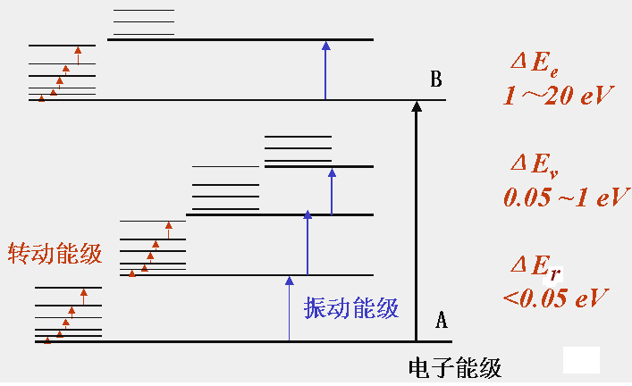
1. The Basis of Molecular Spectroscopy
The motion of a molecule includes:
Valence Electron movement
Nucleus Rotation
Nucleus Vibration
Electron Energy Level
Rotation Energy Level
Vibration Energy Level
Different motions possess different energy levels.
When an electron or a nucleus absorbs light (which has an energy equal to certain energy level gap), the electron/nucleus transitions to the certain energy level. Thus, molecular spectroscopy is produced.

Slide 3
The energy needed for transition between different electron levels is ΔE_{e} = 1～20 eV.
This equals to energies of lights/electro-magnetic wavelength around 1000-50nm，which is in the UV-Vis region.
This means, the emergence of UV-Vis spectroscopy is attributed to the electron level transitions when the molecule absorbs lights in the UV-Vis region.
Notes：The transition of electrons is always accompanied with electron vibrations and rotations, therefore, the UV-Vis spectrum is not only electron spectrum, but also includes electron vibration/rotation spectra.
(So, how to distinguish the spectra of electron transition/vibration/rotation? To be continued…)

Slide 4
2. Mechanism for UV-Vis Spectroscopy
1) Molecular Orbital Theory
According to molecular orbital theory, when two atoms combine to be a molecule, a linear combination of the atom orbits produces two molecular orbitals – bonding orbital (lower energy) and anti-bonding orbital (higher energy). Electrons are usually on the bonding orbital, and promoted to the anti-bonding orbital after absorbing energy, in another word, excitation.
bonding orbital: σ,π
σ-bond, π-bond
anti-bonding orbital: σ*, π*
lone pair electron/n-electron: non-bonding orbital (n)
Notes:
英: Chapter 1.1, 1.2 成键反键轨道与能级跃迁

Slide 5
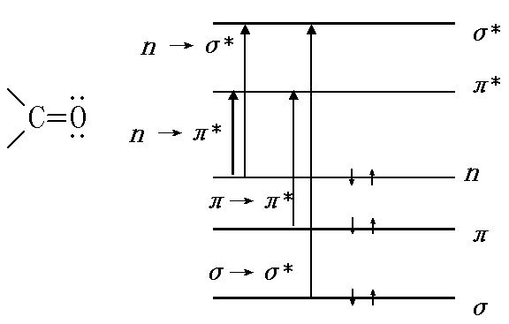
2) Electron transition/promotion
Anti-bonding
Non-bonding
Bonding
Transitions: σ→σ* π→π* n→σ* n→π*

Slide 6
Transition | Relative Energy | Wavelength | Intensity | Related Structures
σ→σ* | High | 150 - 160 nm | N/A | C-C, C-H
π→π* | Medium | 160 – 180 nm non-conjugated double bond >200 nm conjugated double bond | Strong (ε = 10⁴) | C=C, C=C-C=C, Aryls
n→σ* | Medium | ~ 200 nm | Weak (ε ~ 100) | C-O, C-S, C-X, C-N
n→π* | Low | 270 -300 nm or even longer | Weak (ε ~ 100) | C=O, C=S, C=N
ε
Notes:
中: Chapter 3.2.1 各种吸收带及强度,选律
英: Chapter 1.7

Slide 7
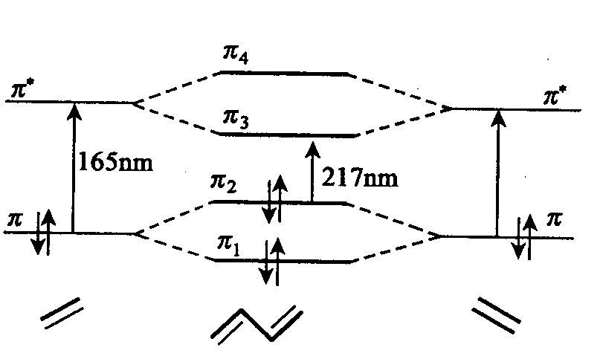
π−π*: conjugated vs non-conjugated
Ethene vs 1,3-butadiene

Slide 8
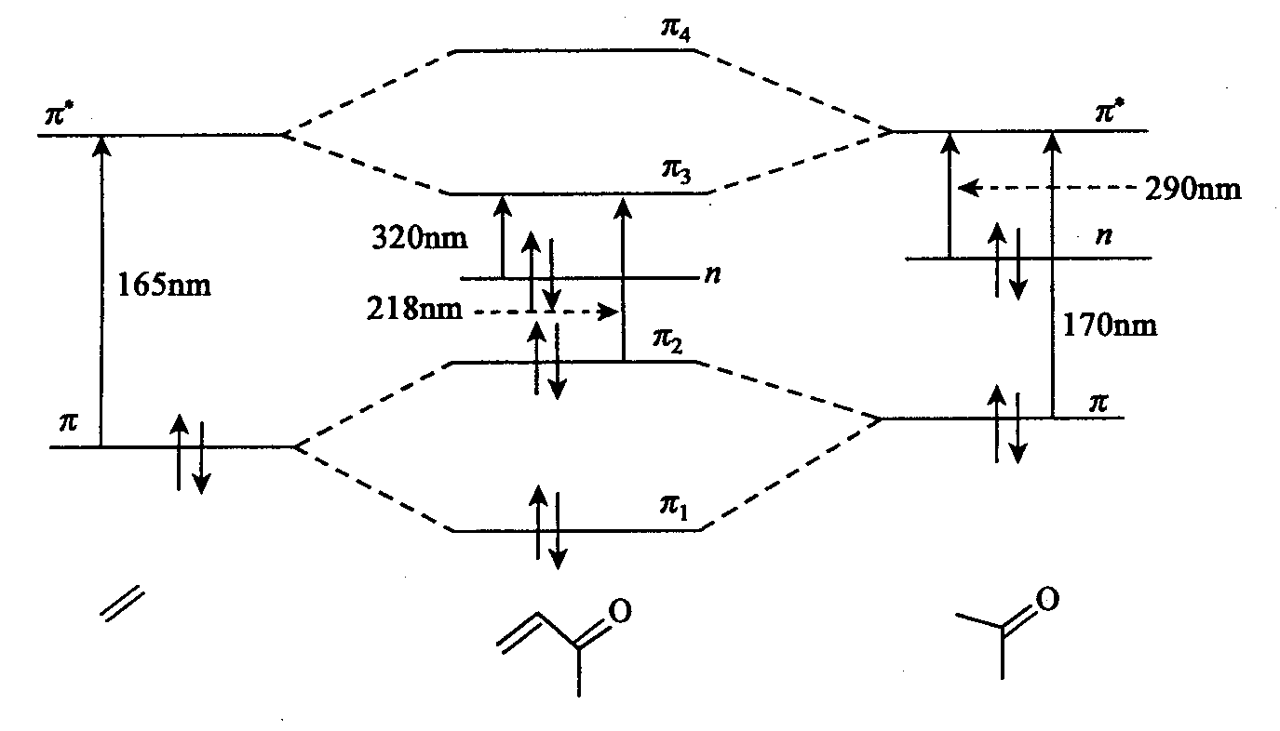
π−π∗
π−π∗ + n−π∗
π−π∗ + n−π∗
Ethene
But-3-en-2-one
Acetone
The longer the conjugated system, the longer the wavelength of the absorption maximum.

Slide 9
Selection Rules and Intensity
Lambert-Beer Law:
log I₀/I = ε.l.c
ε = 0.87 x 10²⁰ P.a
I₀: intensity of incident light
I: intensity of transmitted light
ε: molar extinction coefficient
l: path length of the solution
c: concentration
P: transition probability (0-1)
a: target area
Intensity ∝ ε ∝ P & a
For P: it depends on the allowedness and forbiddeness of the electron transition.
For a: it depends on the size of the molecule (for common chromophore, is conjugation)
The longer the conjugated system, the more intense the absorption

Slide 10
3) Definitions
Chromophore (生色团)：Functional groups which have absorptions in UV and visible regions, such as：>C＝C<、>C＝O、>C＝S、－C≡N、－NO₂、－C₆H₅ and etc (conjugated and non-saturated groups).
Auxochrome (助色团): A substituent on a chromophore which leads to a red shift, such as：－OH、－OR、－NH₂、－NHR、－NR₂、－SH、－Cl (with lone pair atoms).
Red shift / Bathochromic effect (红移): Absorption maximum shifts to a longer wavelength.
Blue shift / Hypsochromic effect (蓝移): Absorption maximum shifts to a shorter wavelength.
Notes:
英: Chapter 1.10 名词解释
中: Chapter 3.5

Slide 11
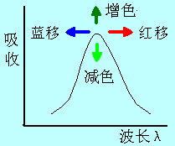
Hypochromic effect (减色效应)：An effect leads to a decreased absorption intensity.
Hyperchromic effect (增色效应): An effect leads to a increased absorption intensity.
Isosbestic point (等吸收点)

Slide 12
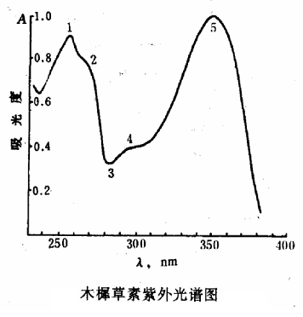
Spectrum：
λ_{max}（最大吸收波长）: Spectrum position
ε_{max}（最大摩尔吸光系数）: Absorption intensity at λ_{max}

Slide 13
